Slide 1
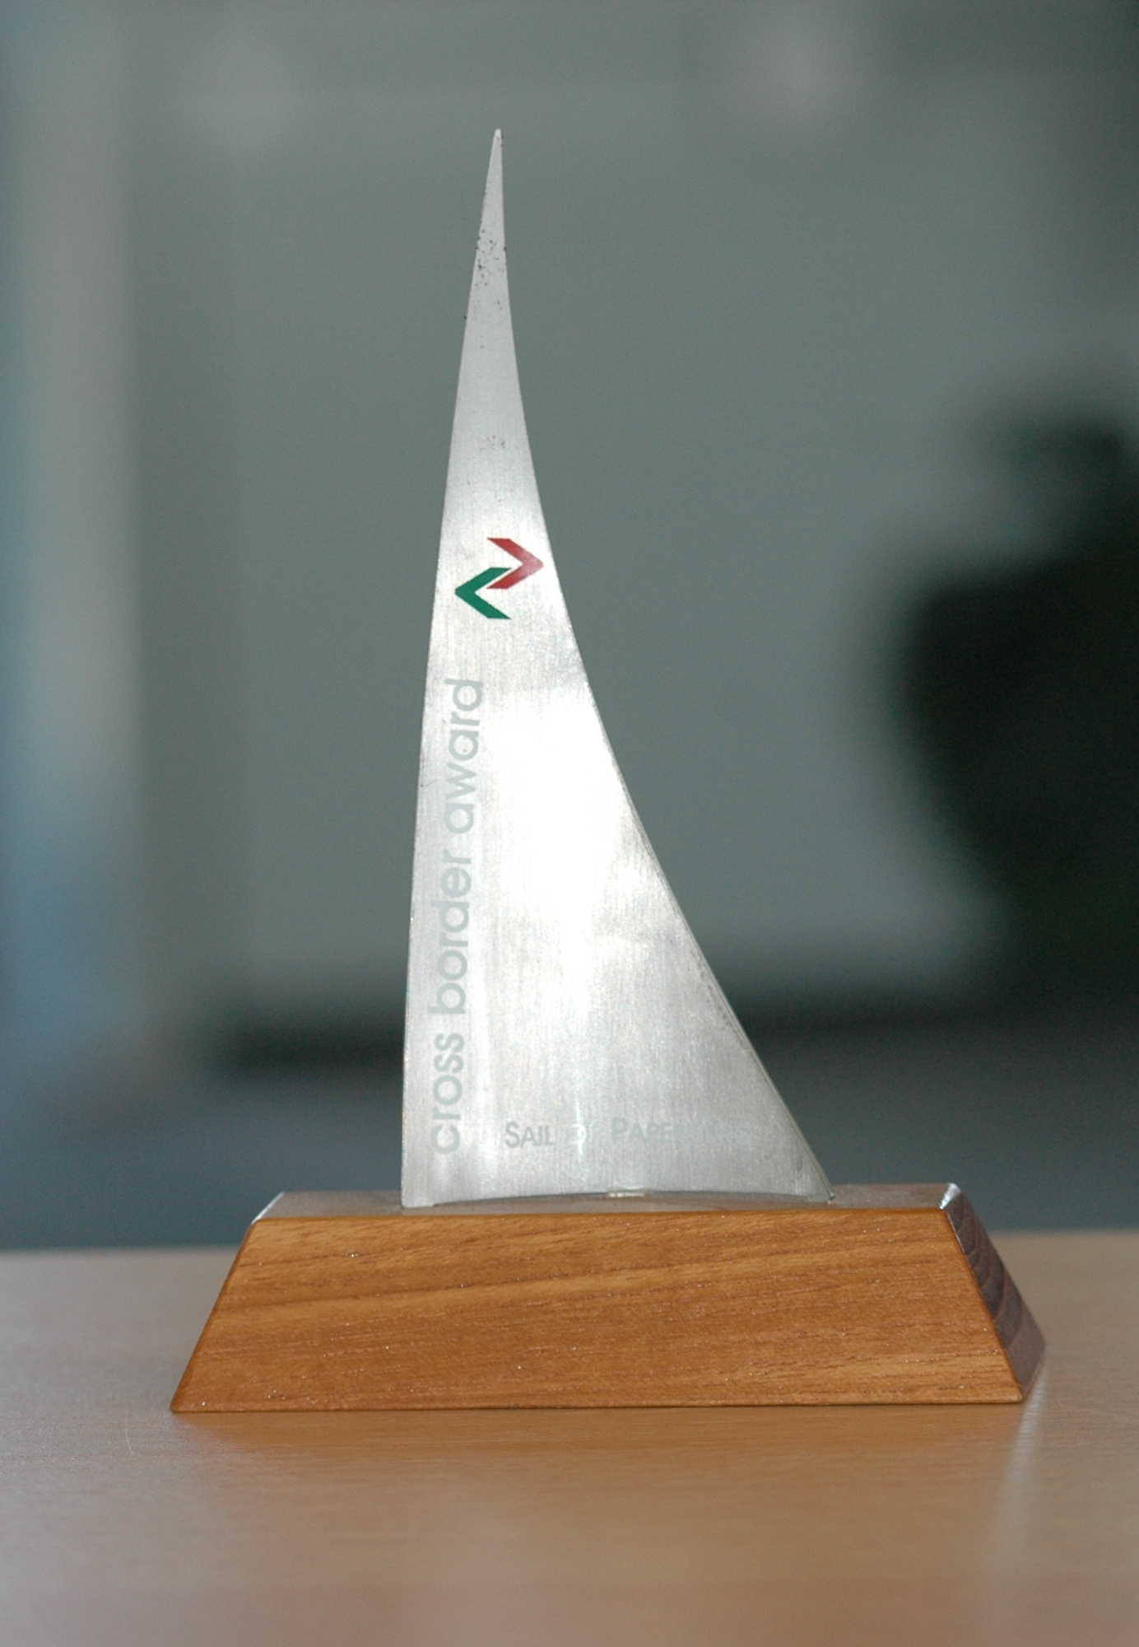


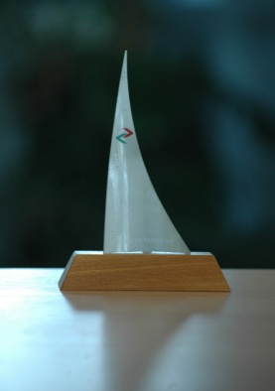

AEBR Cross Border Award "Sail of Papenburg"
Main idea
On the occasion of the Annual Conference and General Assembly 2002 (Papenburg/Groningen) of the Association of European Border Regions (AEBR), the Ems Dollart Region (EDR) endowed the AEBR 'Sail of Papenburg' Cross-Border Award.
The award honours particular achievements in the area of cross-border cooperation, e.g. in the cultural, economic, institutional, environmental and social sphere in a border or cross-border region.
The award honours and motivates: it honours outstanding programmes / strategies, projects and actions within the scope of cross-border co-operation that preferably can be seen as exemplary. At the same time it should motivate border and cross-border regions to actively contribute to a better understanding and better relations at the borders between the nations throughout Europe. Thereby European integration at the borders will be directly promoted.
Although the Sail of Papenburg is above all a prestige award, in exceptional circumstances prize money may be granted to financially support efforts made by a particular region.
Presentation by AEBR
Target criteria:
Honoured are outstanding achievements in and / or by a border and cross-border region (subnational entities). In principle only organisations aiming to boost direct neighbourly cooperation along a national border are eligible for the award¹. They include in particular institutionalised cross-border associations (eg. Euroregions and similar structures). Membership in the European Union or AEBR is not required.
Applicants may submit cross-border projects (individual and packages), measures and / or also overall achievements / efforts (programmes / strategies) in a border or cross-border region.
The specific guidelines for every year (motto, individual project or programme / strategy etc.) are settled by the AEBR.
The motto for the year 2020 is:
Covid-19 – re-opening of borders. Joint measures and solutions ins border regions.
¹ The award does not honour interregional or transnational projects and programmes.
+7

Slide 2
The achievement winning the award should be so convincing that others are induced to imitate it. The practical feasibility and application of model solutions should therefore be paramount.
Individual or joint achievements that are innovative in their approach and exceptionally effective are given particular consideration.
When evaluating achievements, the quality of the individual measures implemented as well as some projects and/or a programme / a strategy are taken into account. At the same time, cross-border cooperation in particular contexts (specific difficulties, etc.) and supra-regional / European significance is also taken into account. What will be decisive is also the added value (e.g. cross-border, European etc.).
Procedure:
The Executive Committee and the Secretary General call on and set a deadline for border and cross-border regions to submit proposals and specify a theme annually.
The measures entering into consideration for the Award should be in line with the motto 2020 have been carried out to a large extend and their impacts should be effective or at least clearly recognisable in the year 2020. Any project, which has already received an award, will not be considered again.
Evaluation:
The winner of the AEBR Cross-Border Award is decided by majority decision on the part of the members of the AEBR Executive Committee.
An independent panel appointed by the Executive Committee for a three-year period assesses the submitted proposals (evaluation sheet is enclosed in the annex).
The panel should consist of at least five members and presents the assessed proposals to the Executive Committee for final decision.
Bestowing the award:
The award winner receives a ‘Sail of Papenburg’ award.
Usually the award ceremony takes place each year at the AEBR Annual Conference/General Assembly. The laureate is informed prior to the General Assembly/Annual Conference.
(2020)
Award Winners
2002 - 2019
2002: EUROREGION LOWER DANUBE (MD/RO/UA)
2003: EUREGIO STEIERMARK-
NORTH-EAST-SLOVENIA (AT/SLO)
2004: EUREGIO (DE/NL)
2005: IRISH CENTRAL BORDER AREA NETWORK (ICBAN) (IE/GB)
2006: AUTONOMOUS REGION FRIULI VENEZIA GIULIA (I)
2007: EUREGIO RHINE WAAL (DE/NL)
2008: Two first prizes:
UPPER RHINE REGION (CH/FR/DE) &
EUROREGION GALICIA-NORTE DE PORTUGAL (ES/PT)
2009: EUREGIO SCHELDEMOND (BE/NL) &
Special Award: EUROREGIO LVIV (PL/HU)
2010: EUROREGION NESTOS-MESTA (GR/BG) &
Special Award: ÖRESUND COMITTEE (DK/SE)
2011: ÖRESUND COMMITTEE (DK/SE) &
Special Award: EUROREGION SPREE-NEISSE-BOBER (DE/PL)
2012: Two first prizes:
EURO REGIÓN GALICIA – NORTE DE PORTUGAL (ES/PT) &
UPPER AUSTRIA/MÜHLVIERTEL-
SOUTH BOHEMIA (AT/CZ)
2013: LOWER AUSTRIA – BURGENLAND - BRATISLAVA (AT/SK)
2014: EUREGIO MEUSE-RHINE (NL/BE/DE)
2015: NORTH WEST REGION CROSS BORDER GROUP (IE/GB)
2016: KVARKEN REGION (FI/SE) &
Special Award: EGTC AQUITAINE-EUSKADI (FR/ES)
2017: INTERNATIONAL LAKE CONSTANCE REGION (AT/CH/DE/FL)
2018: EVTZ EURODISTRICT PAMINA (F/D)
2019: GALICIA – NORTE DE PORTUGAL (ES/P)
Special Award: EGTC EUROREGION PYRENEES-MEDITERRANEAN (ES/F)
Association of European Border Regions (AEBR)
The AEBR was established in 1971 by 10 founding members. It acts for the benefit of all border/cross-border regions in Europe. The AEBR is the only European wide association dealing exclusively with cross-border cooperation and one of the main players in regional policy at European level. www.aebr.eu

